Slide 1

MVP DEMO PRESENTATION
Presented by :
Team 16
1

Slide 2


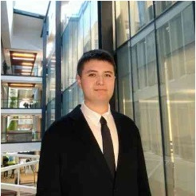


Our Team
1
Jessica goel
Mridul Nohria
Yerdana Maulenbay
Rhythm Trivedi
Bao Tran
Frontend Developer
Integration Lead / DevOps / QA Lead
Backend Developer
Frontend Developer
Backend Developer
2

Slide 3
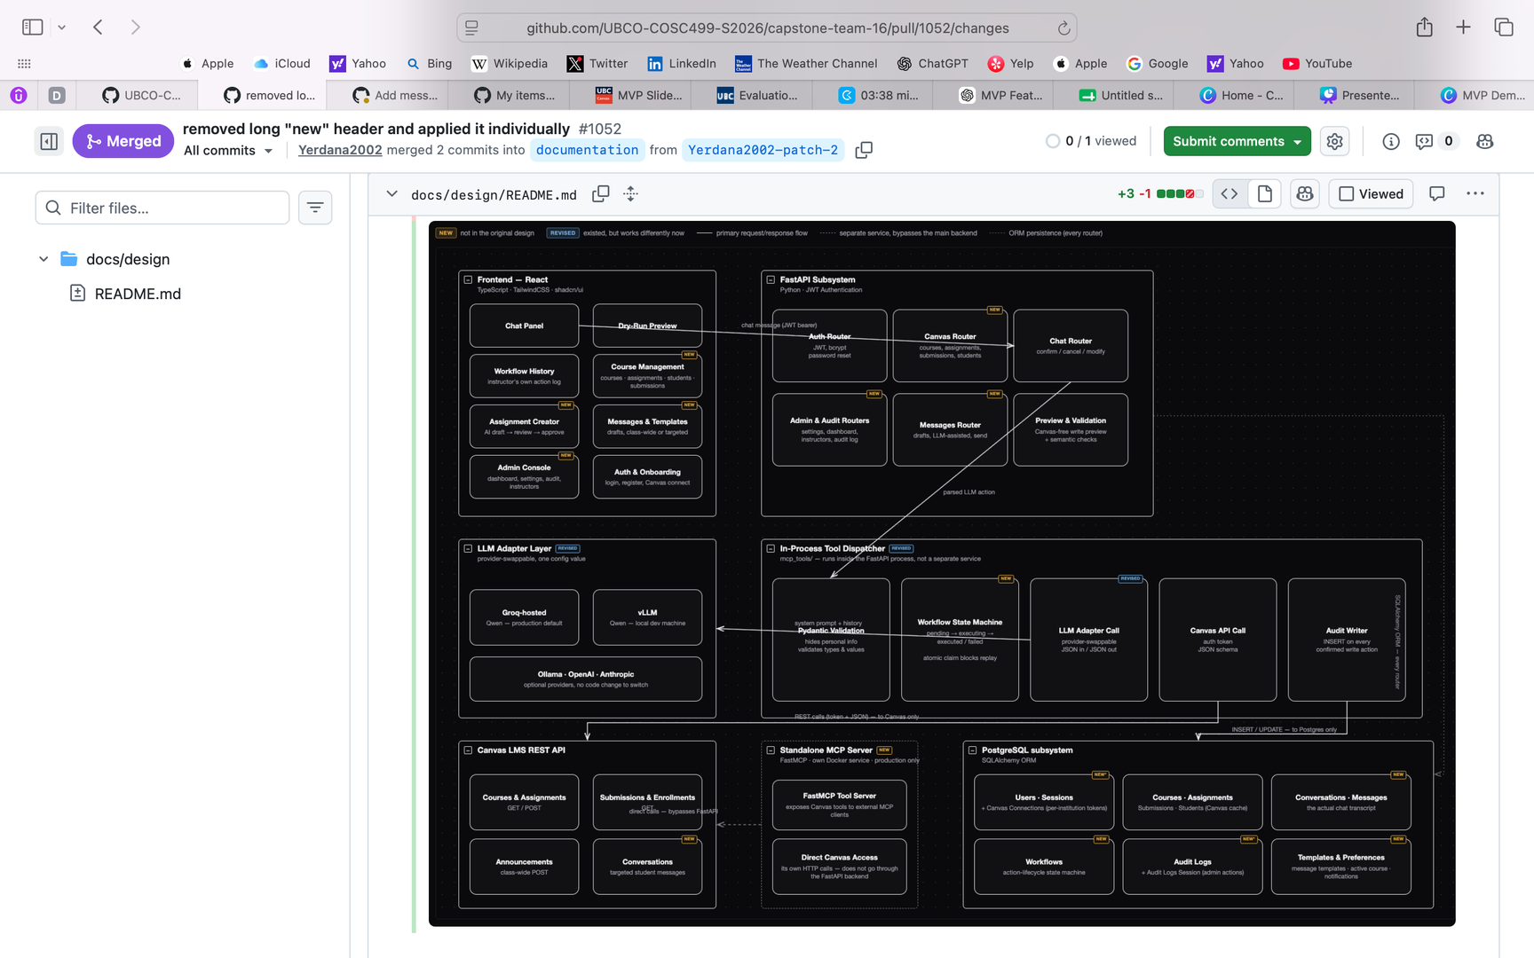
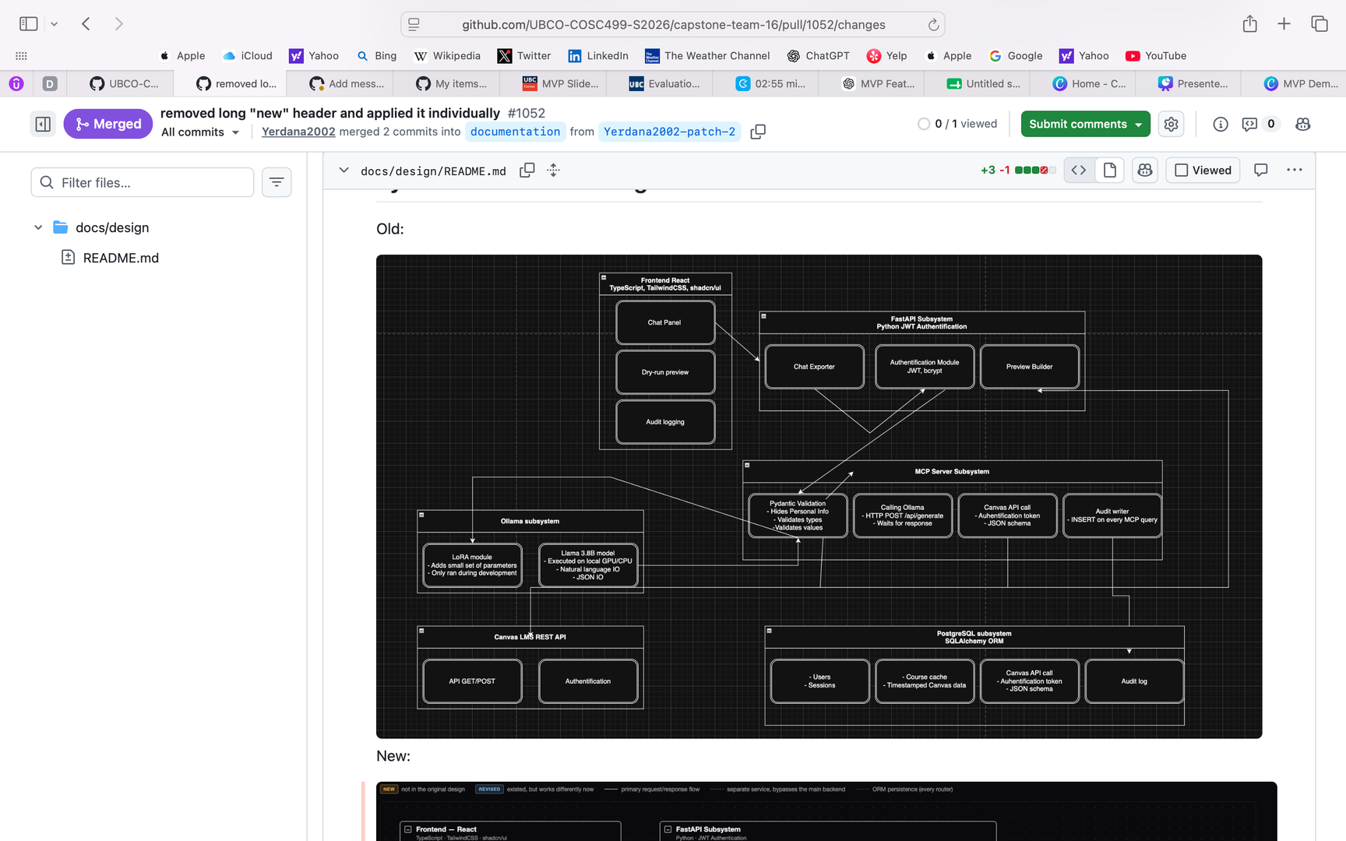
CHANGES MADE
OLD SYSTEM ARCHITECTURE
NEW SYSTEM ARCHITECTURE
  Single local Ollama model for AI processing.
  AI requests routed directly through the MCP server.
  Monolithic backend with fewer separated services.
  Basic database structure for authentication and Canvas data.
  Added a provider-independent LLM Adapter Layer supporting both local and cloud-hosted models.
  Refactored the backend into modular routers (Authentication, Canvas, Chat, Preview, Messages, Admin).
  Introduced a workflow engine with validation before Canvas actions.
  Expanded PostgreSQL to support conversations, workflows, templates, and audit logs.
  Improved scalability, maintainability, and AI safety.
3
Notes:
Since our last milestone, we made some significant architectural changes, and I want to walk you through why. Our old system architecture relied on a single local Ollama model for all AI processing, with requests routed directly through the MCP server, a fairly monolithic backend, and a basic database structure that only really handled authentication and Canvas data. In our new architecture, we introduced a provider-independent LLM Adapter Layer, so we're no longer locked into one local model — we can now support both local and cloud-hosted providers. We also refactored the backend into modular routers: Authentication, Canvas, Chat, Preview, Messages, and Admin. On top of that, we added a workflow engine that validates actions before anything touches Canvas, and we expanded our PostgreSQL schema to support conversations, workflows, templates, and audit logs.

Slide 4
WHY WE CHANGED IT
  Support multiple LLM providers instead of relying only on local models.
  Reduce hardware requirements by allowing cloud-hosted models.
  Make the system easier to extend and maintain.
  Improve security and validation before executing Canvas operations.
  Better align the architecture with project requirements and future milestones.
Impact: The new architecture is more scalable, supports multiple AI providers, improves security, and simplifies future feature development.
4
Notes:
We made these changes for a few concrete reasons. First, relying on a single local model limited us — we wanted flexibility to support multiple LLM providers and reduce hardware requirements by allowing cloud-hosted options. Second, the modular backend makes the system dramatically easier to extend and maintain going forward. And third, the workflow engine gives us proper validation before executing Canvas operations, which improves both security and safety. The overall impact is a system that's more scalable, supports multiple AI providers, is more secure, and sets us up to build new features much faster than before.

Slide 5
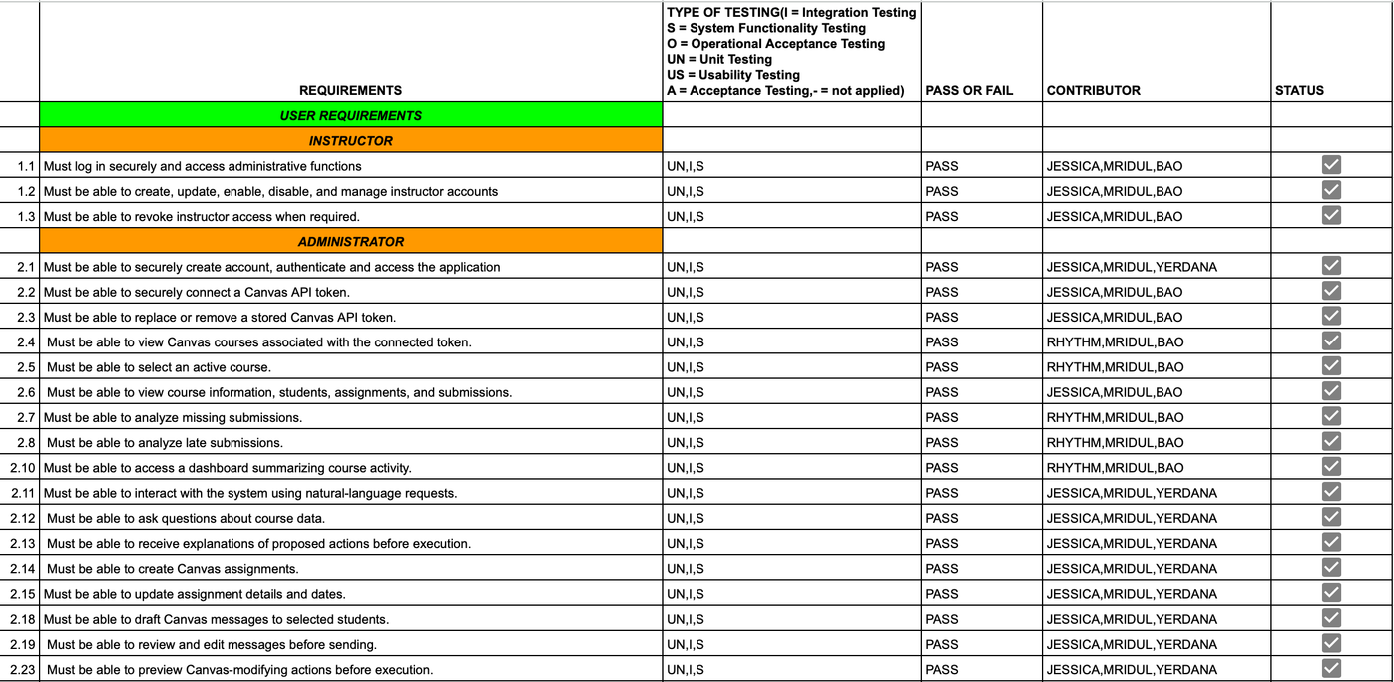
COMPLETED TASKS TESTING REPORT
5
Notes:
This is our requirements testing report, tracked against our WBS and user requirements. As you can see, we've broken this down by user role — Instructor and Administrator — and mapped each requirement to a testing type: unit, integration, system, or acceptance testing. Every single requirement listed here is currently passing. That includes core administrator flows like securely connecting a Canvas API token, viewing and selecting active courses, analyzing missing and late submissions, and the natural-language assistant capabilities — asking questions about course data, drafting and previewing messages, and reviewing or cancelling proposed Canvas actions before execution. At this stage, we've completed all of our planned MVP frontend, backend, and integration features, which puts us at roughly full completion of our Feature Set #1 scope — the rest of our remaining work going forward is testing depth, bug fixing, and refinement rather than net-new features

Slide 6
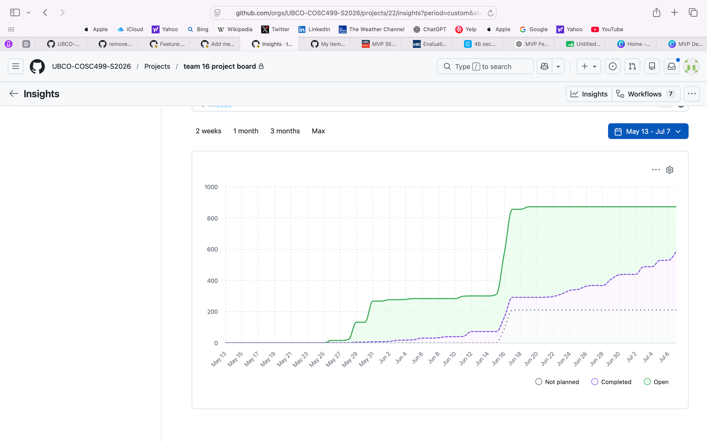
BURN UP
Reflection (Up to Today)
  Project scope expanded significantly as detailed MVP features and sub-issues were added during planning.
  Steady completion of frontend, backend, and integration features throughout the milestone.
  Large increase in completed work near the MVP deadline as integrated features were finalized and merged.
Moving Forward
  Continue completing remaining milestones with more consistent progress each week.
  Increase focus on testing, bug fixing, and code quality.
  Maintain smaller, incremental issue completion to reduce end-of-milestone workload.
6
Notes:
Here's our burn-up chart tracking planned versus completed work over time. You can see the scope — the green line — expanded significantly in mid-June as we added detailed MVP features and sub-issues during planning. Completion, the purple dashed line, climbed steadily through the milestone, with a large jump right near the MVP deadline as integrated features were finalized and merged. Going forward, our goal is more consistent week-to-week progress, more focus on testing and code quality, and smaller incremental completions so we're not backloading work at the end of each milestone.

Slide 7
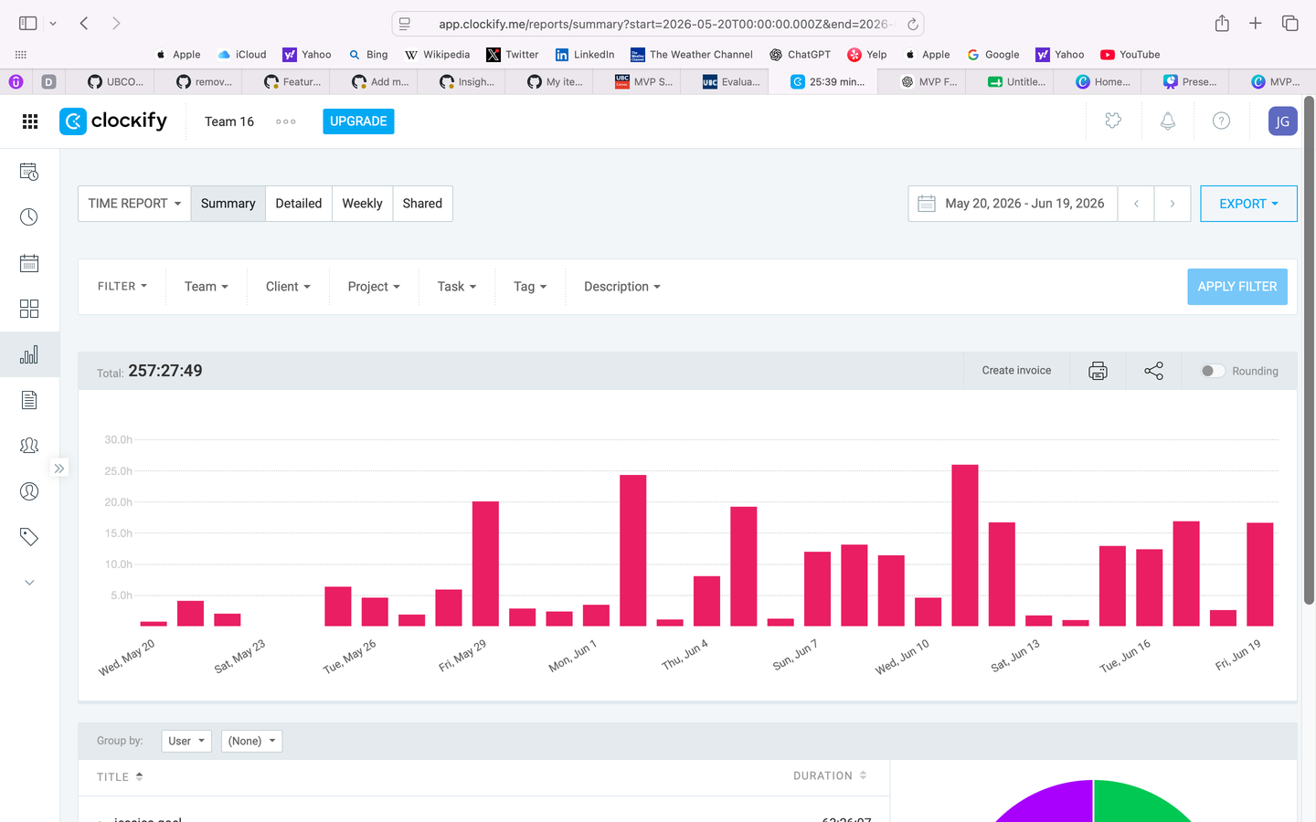
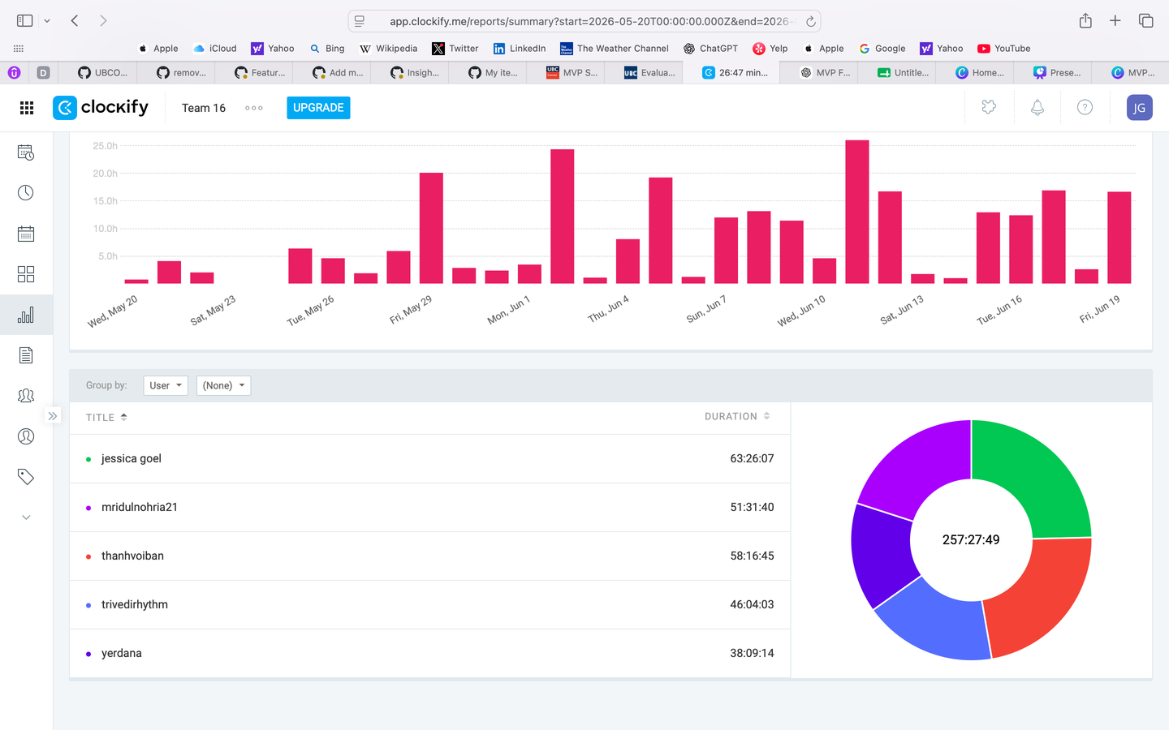
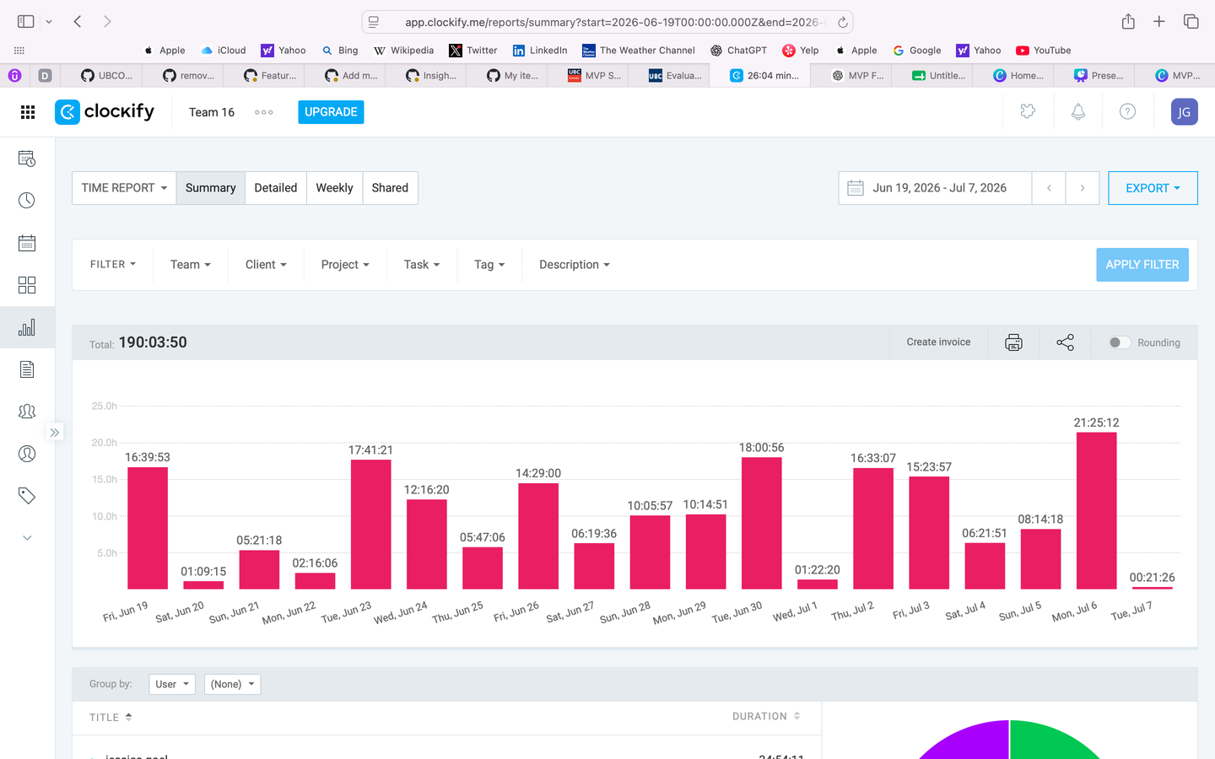
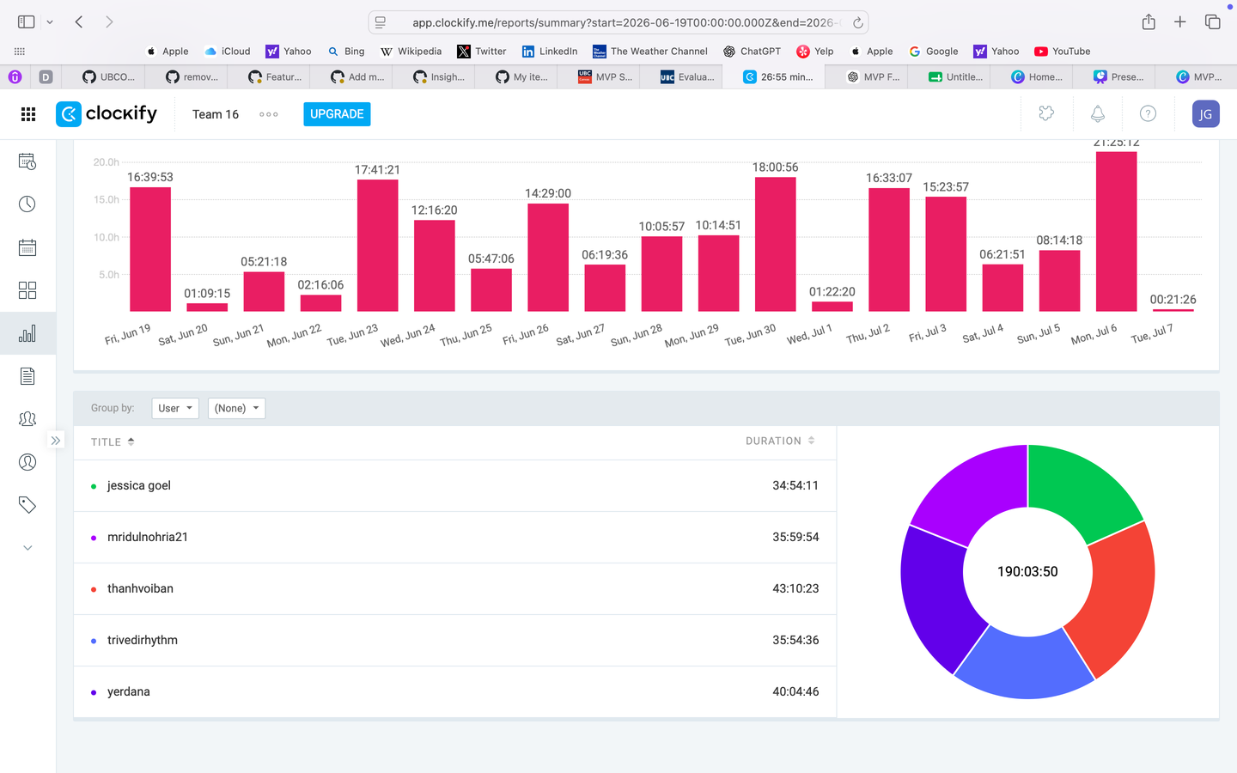
TIME CONTRIBUTION
Progress to Date
  448 team hours logged.
  Completed all planned MVP frontend, backend, and integration features.
  Successfully delivered Feature Set #1 and achieved MVP functionality.
  Development effort focused on implementation, integration, and validation
Moving Forward
  Prioritize comprehensive testing and bug fixing.
  Improve test coverage and system reliability.
  Refine UI/UX based on feedback.
  Continue implementing remaining features for the final release.
7
Notes:
In terms of hours, we've logged 448 team hours to date, split fairly evenly across the five of us, as shown in the breakdown here. That effort has gone primarily into implementation, integration, and validation work, and it's what got us to a fully functional MVP with Feature Set #1 delivered. Moving forward, we're allocating more of our estimated hours toward comprehensive testing and bug fixing, improving test coverage and reliability, and refining the UI and UX based on feedback.

Slide 8
TESTING
Testing Type Framework/Tool Coverage Status
User,
Course,
Application models
Unit Tests
(Models/Logic)
Pytest
Active
DOM behavior
form validation
Frontend Tests
Vitest
Active
CI Test Automation
GitHub Actions
Run on every PR
Active
8
Notes:
On the testing side, we have three active layers in place. Pytest covers our unit tests for models and logic — users, courses, and application models. Vitest covers our frontend tests — DOM behavior and form validation. And GitHub Actions runs our full test suite automatically on every pull request, so nothing merges without passing CI.

Slide 9
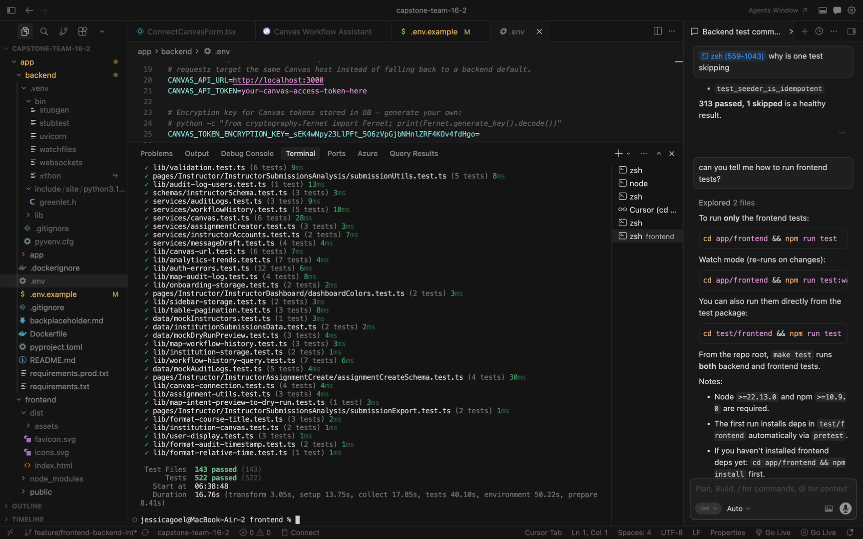
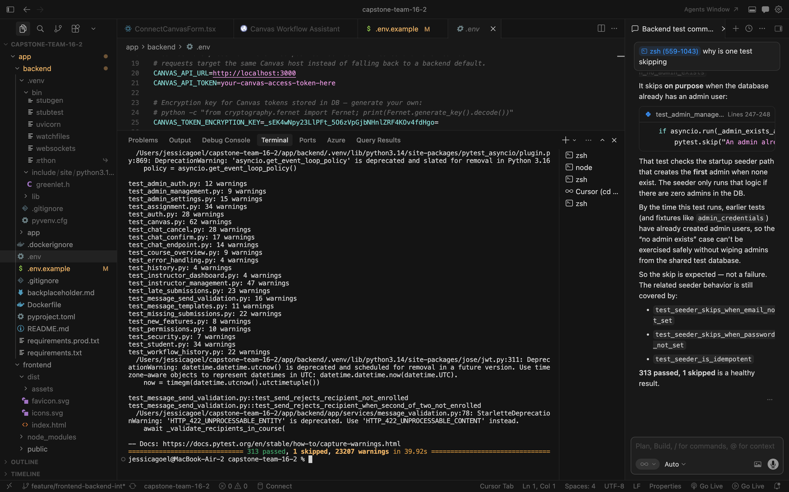
FRONTEND TESTS:
BACKEND TESTS:
9
Notes:
And here's the proof in practice. On the frontend, our latest Vitest run shows 143 test files and 522 individual tests, all passing, covering everything from validation logic and audit logs to workflow history, Canvas connections, and assignment creation. On the backend, our Pytest suite covers areas like authentication, admin management, chat, course overviews, missing and late submissions, message validation, and workflow history — 313 tests passing, with just one skipped. So testing isn't an afterthought here — it's running continuously alongside development, which is exactly what's let us move this fast with confidence in what we're shipping

Slide 10
LIVE DEMO
01
Natural Language Assistant
03
Assignment Creation with Dry-Run Preview
02
Course Dashboard & Submission Analytics
04
Instructor Account Management
10
Notes:
. That brings us to the live demo. ill hand it over to yerdana now

Slide 11
ANY QUESTIONS?
11
Notes:
That wraps up our demo. We'd love to open it up for any questions you have — about the architecture, our testing approach, the roadmap, or anything you saw in the demo.

Slide 12
THANK YOU
12

